Slide 1
The influence of COVID-19 lockdowns on the price of Bitcoin
By Codrin Nane Popa

Slide 2
In this project I researched to see if the covid-19 pandemic had any effect on the price of bitcoin

Slide 3
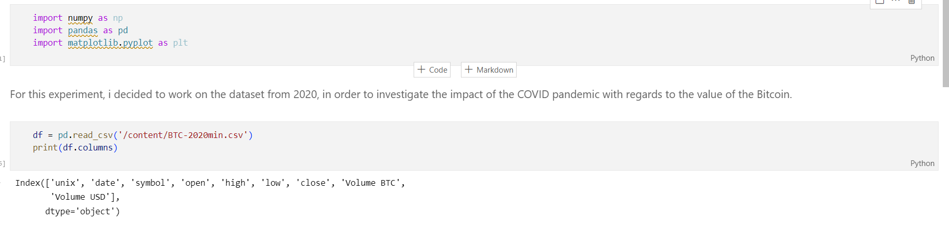
I started with importing the data

Slide 4
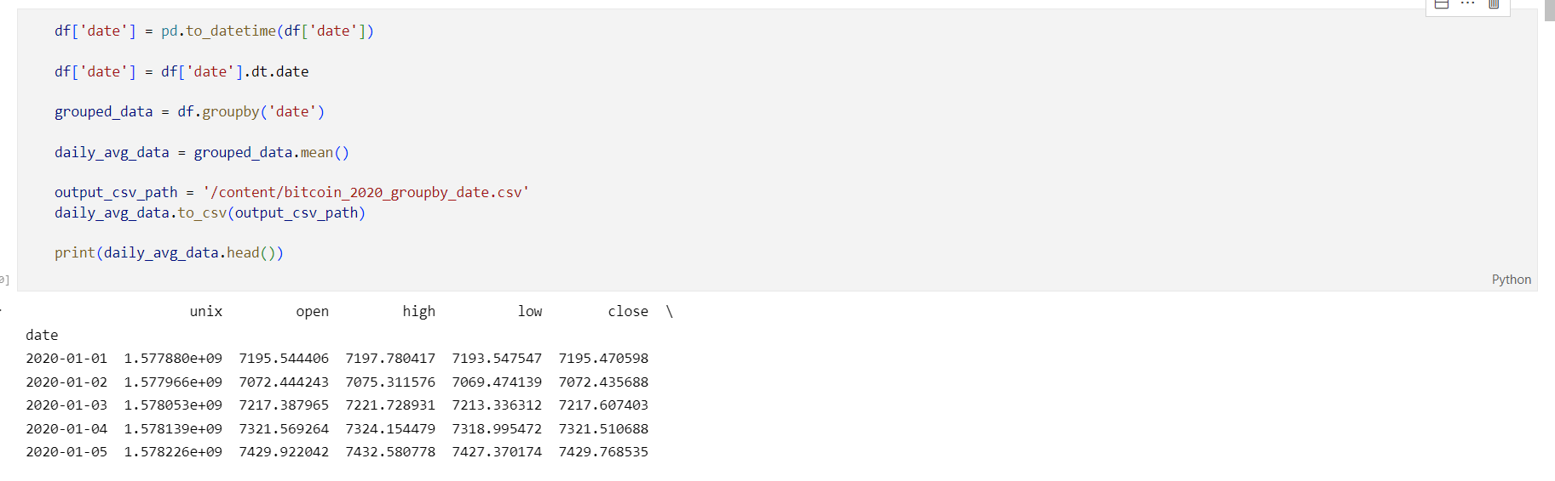
Since the data also included the hourly price, I decided to average them to see the daily price

Slide 5
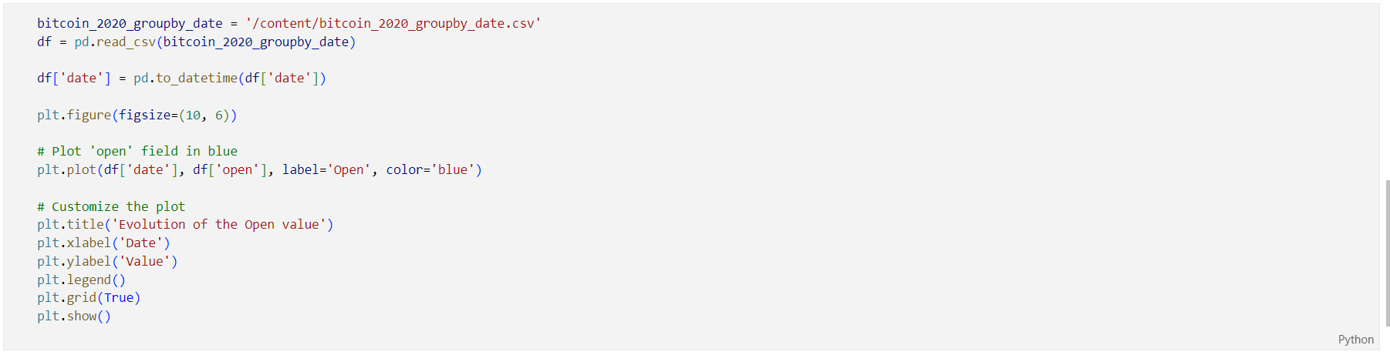
I decided to plot the evolution of the "open" value from the dataset. This number represents the value of the bitcoin from the respective day.

Slide 6
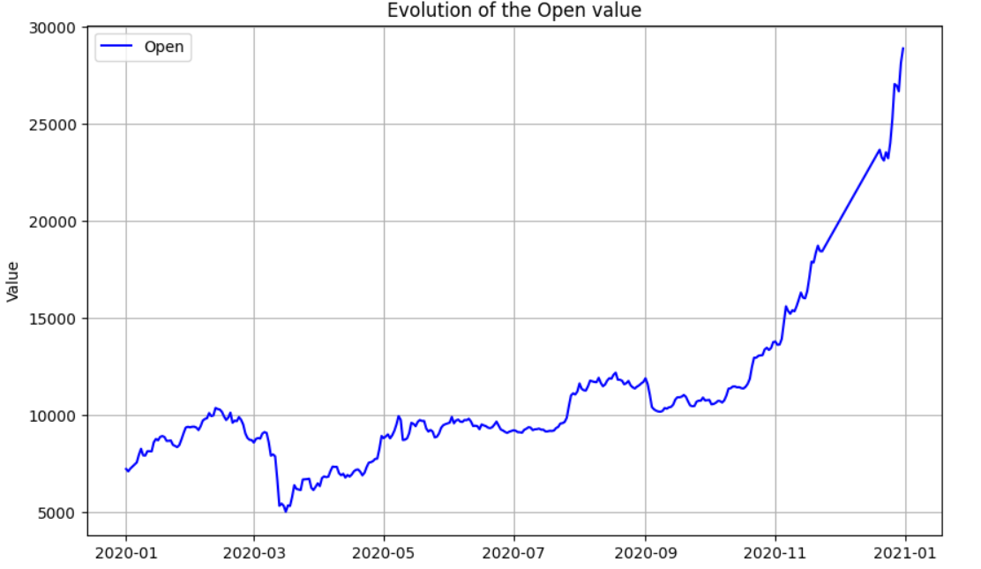

Slide 7
Conclusions
As we can see, the price of BTC sharply dropped in March, which corresponds with the period of imposed lockdowns all around the world. My theory is that this happened due to uncertainty of what is to come. We see a steady growth afterwards, after the world started to adapt to the current situation at the time, following a sharp spike after the announcement that COVID-19 measures where to be relaxed

Slide 8
Thank you!

